Slide 1
Disk Storage, Basic File Structures, and Hashing

Slide 2
Chapter Outline
Disk Storage Devices
Files of Records
Operations on Files
Unordered Files
Ordered Files
Hashed Files
Dynamic and Extendible Hashing Techniques
RAID Technology

Slide 3
Disk Storage Devices
Preferred secondary storage device for high storage capacity and low cost.
Data stored as magnetized areas on magnetic disk surfaces.
A disk pack contains several magnetic disks connected to a rotating spindle.
Disks are divided into concentric circular tracks on each disk surface.
Track capacities vary typically from 4 to 50 Kbytes or more

Slide 4
Disk Storage Devices (contd.)
A track is divided into smaller blocks or sectors
because it usually contains a large amount of information
The division of a track into sectors is hard-coded on the disk surface and cannot be changed.
One type of sector organization calls a portion of a track that subtends a fixed angle at the center as a sector.
A track is divided into blocks.
The block size B is fixed for each system.
Typical block sizes range from B=512 bytes to B=4096 bytes.
Whole blocks are transferred between disk and main memory for processing.

Slide 5
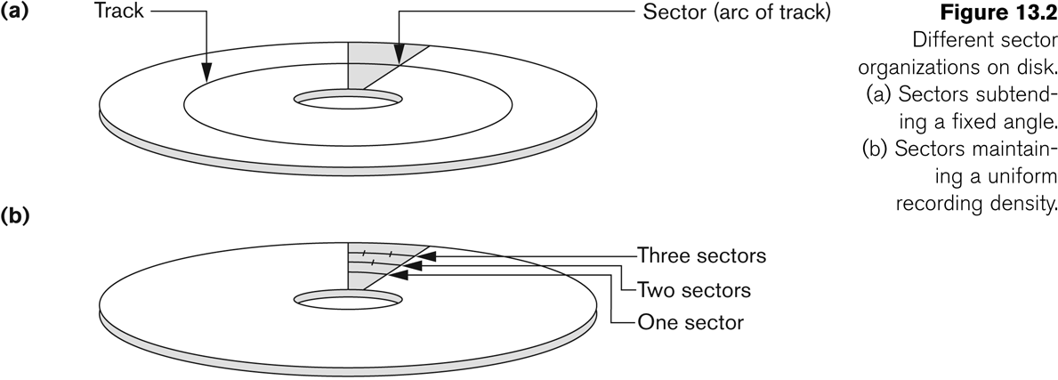
Disk Storage Devices (contd.)

Slide 6
Disk Storage Devices (contd.)
A read-write head moves to the track that contains the block to be transferred.
Disk rotation moves the block under the read-write head for reading or writing.
A physical disk block (hardware) address consists of:
a cylinder number (imaginary collection of tracks of same radius from all recorded surfaces)
the track number or surface number (within the cylinder)
and block number (within track).
Reading or writing a disk block is time consuming because of the seek time s and rotational delay (latency) rd.
Double buffering can be used to speed up the transfer of contiguous disk blocks.
Notes:
Disk I/O Time Components:
Seek Time (sss): This is the time taken by the disk’s read/write head to move to the correct track where the desired block of data is located.
Rotational Delay (Latency) (rdrdrd): Once the head reaches the correct track, the disk needs to rotate so that the desired block aligns with the read/write head. This waiting time is known as rotational delay.
Transfer Time: Once the correct block is under the read/write head, the actual reading or writing of data occurs.
Double Buffering for Speed Optimization:
Concept: Double buffering is a technique where two buffers (temporary storage areas) are used to overlap disk I/O operations with CPU processing.
How It Works:
While data from one buffer is being processed (e.g., copied to memory or used by a program), the next block of data is read into the second buffer.
This way, the CPU does not remain idle while waiting for the disk to fetch the next block.
Advantage: By using double buffering, the system can reduce waiting time and improve the overall speed of transferring contiguous disk blocks, as the CPU and disk operations can work in parallel.

Slide 7
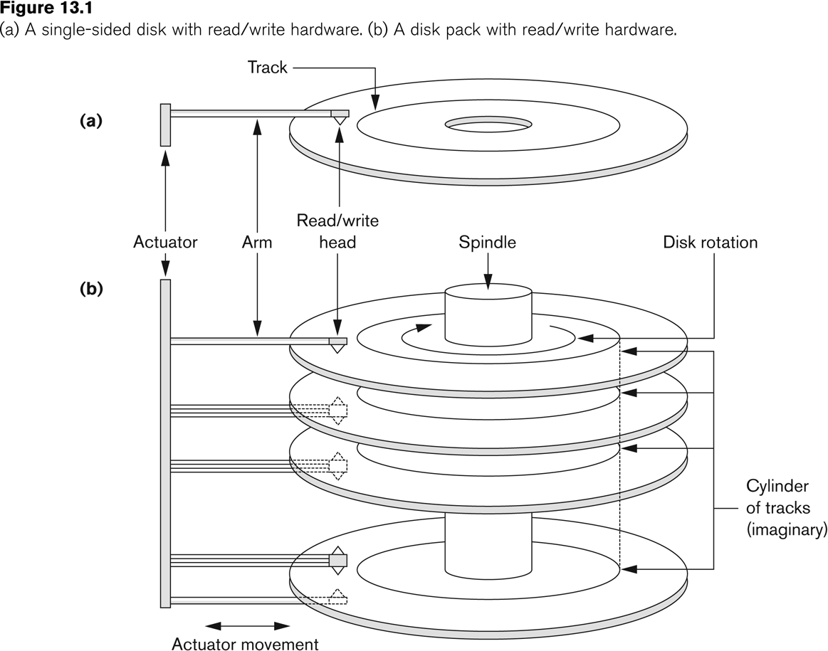
Disk Storage Devices (contd.)

Slide 8
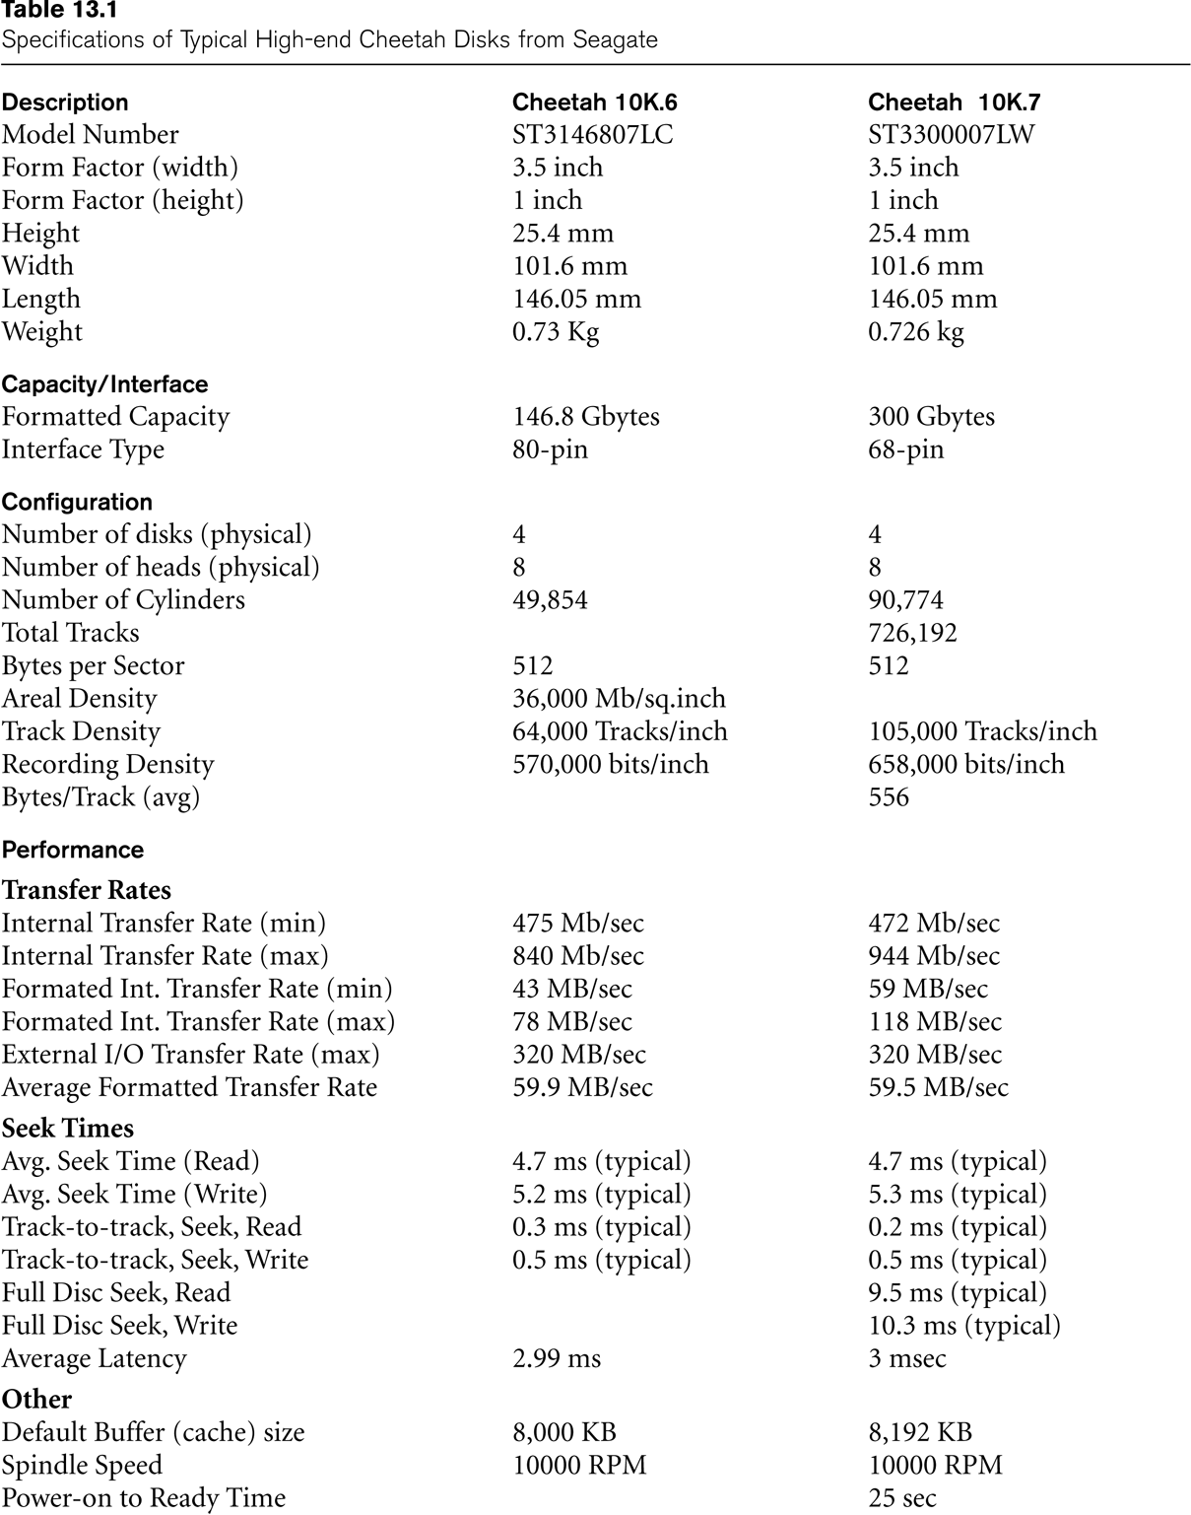
Typical Disk Parameters
(Courtesy of Seagate Technology)

Slide 9
Records
Fixed and variable length records
Records contain fields which have values of a particular type
E.g., amount, date, time, age
Fields themselves may be fixed length or variable length
Variable length fields can be mixed into one record:
Separator characters or length fields are needed so that the record can be “parsed.”

Slide 10
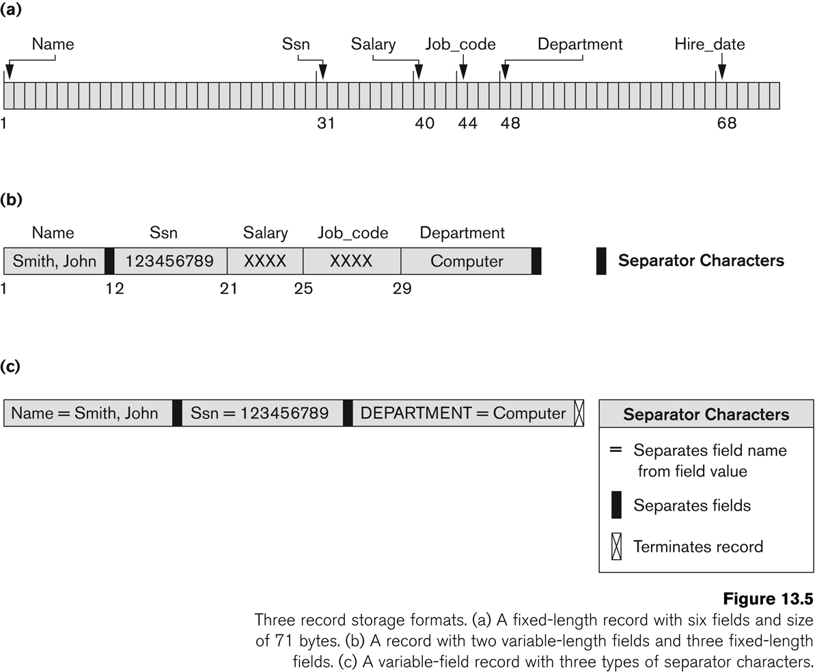

Slide 11
Blocking
Blocking:
Refers to storing a number of records in one block on the disk.
Blocking factor (bfr) refers to the number of records per block.
There may be empty space in a block if an integral number of records do not fit in one block.
Spanned Records:
Refers to records that exceed the size of one or more blocks and hence span a number of blocks.

Slide 12
Files of Records
A file is a sequence of records, where each record is a collection of data values (or data items).
A file descriptor (or file header) includes information that describes the file, such as the field names and their data types, and the addresses of the file blocks on disk.
Records are stored on disk blocks.
The blocking factor bfr for a file is the (average) number of file records stored in a disk block.
A file can have fixed-length records or variable-length records.

Slide 13
Files of Records (contd.)
File records can be unspanned or spanned
Unspanned: no record can span two blocks
Spanned: a record can be stored in more than one block
The physical disk blocks that are allocated to hold the records of a file can be contiguous, linked, or indexed.
In a file of fixed-length records, all records have the same format. Usually, unspanned blocking is used with such files.
Files of variable-length records require additional information to be stored in each record, such as separator characters and field types.
Usually spanned blocking is used with such files.

Slide 14
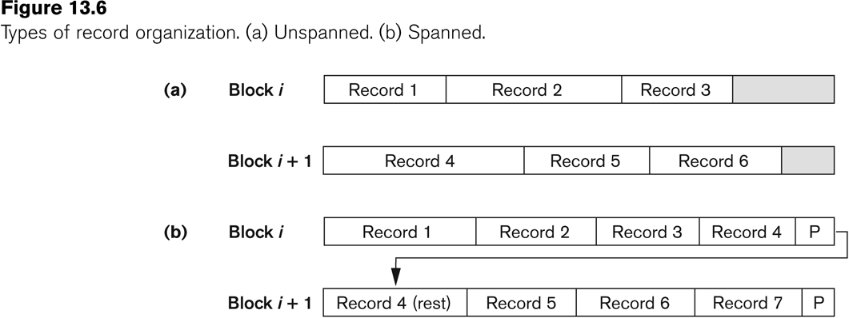

Slide 15
Operation on Files
Typical file operations include:
OPEN: Readies the file for access, and associates a pointer that will refer to a current file record at each point in time.
FIND: Searches for the first file record that satisfies a certain condition, and makes it the current file record.
FINDNEXT: Searches for the next file record (from the current record) that satisfies a certain condition, and makes it the current file record.
READ: Reads the current file record into a program variable.
INSERT: Inserts a new record into the file & makes it the current file record.
DELETE: Removes the current file record from the file, usually by marking the record to indicate that it is no longer valid.
MODIFY: Changes the values of some fields of the current file record.
CLOSE: Terminates access to the file.
REORGANIZE: Reorganizes the file records.
For example, the records marked deleted are physically removed from the file or a new organization of the file records is created.
READ_ORDERED: Read the file blocks in order of a specific field of the file.

Slide 16
Unordered Files
Also called a heap or a pile file.
New records are inserted at the end of the file.
A linear search through the file records is necessary to search for a record.
This requires reading and searching half the file blocks on the average, and is hence quite expensive.
Record insertion is quite efficient.
Reading the records in order of a particular field requires sorting the file records.

Slide 17
Ordered Files
Also called a sequential file.
File records are kept sorted by the values of an ordering field.
Insertion is expensive: records must be inserted in the correct order.
It is common to keep a separate unordered overflow (or transaction) file for new records to improve insertion efficiency; this is periodically merged with the main ordered file.
A binary search can be used to search for a record on its ordering field value.
This requires reading and searching log₂ of the file blocks on the average, an improvement over linear search.
Reading the records in order of the ordering field is quite efficient.

Slide 18
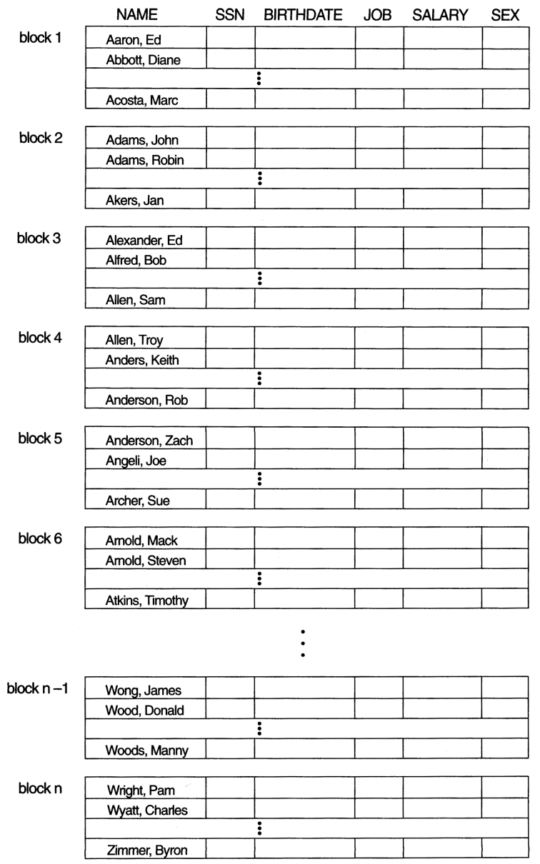
Ordered Files (contd.)

Slide 19
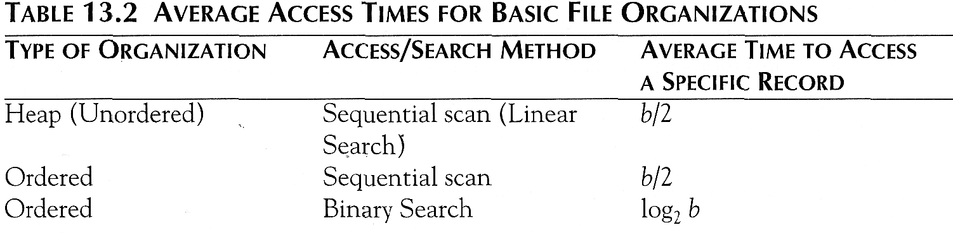
Average Access Times
The following table shows the average access time to access a specific record for a given type of file

Slide 20
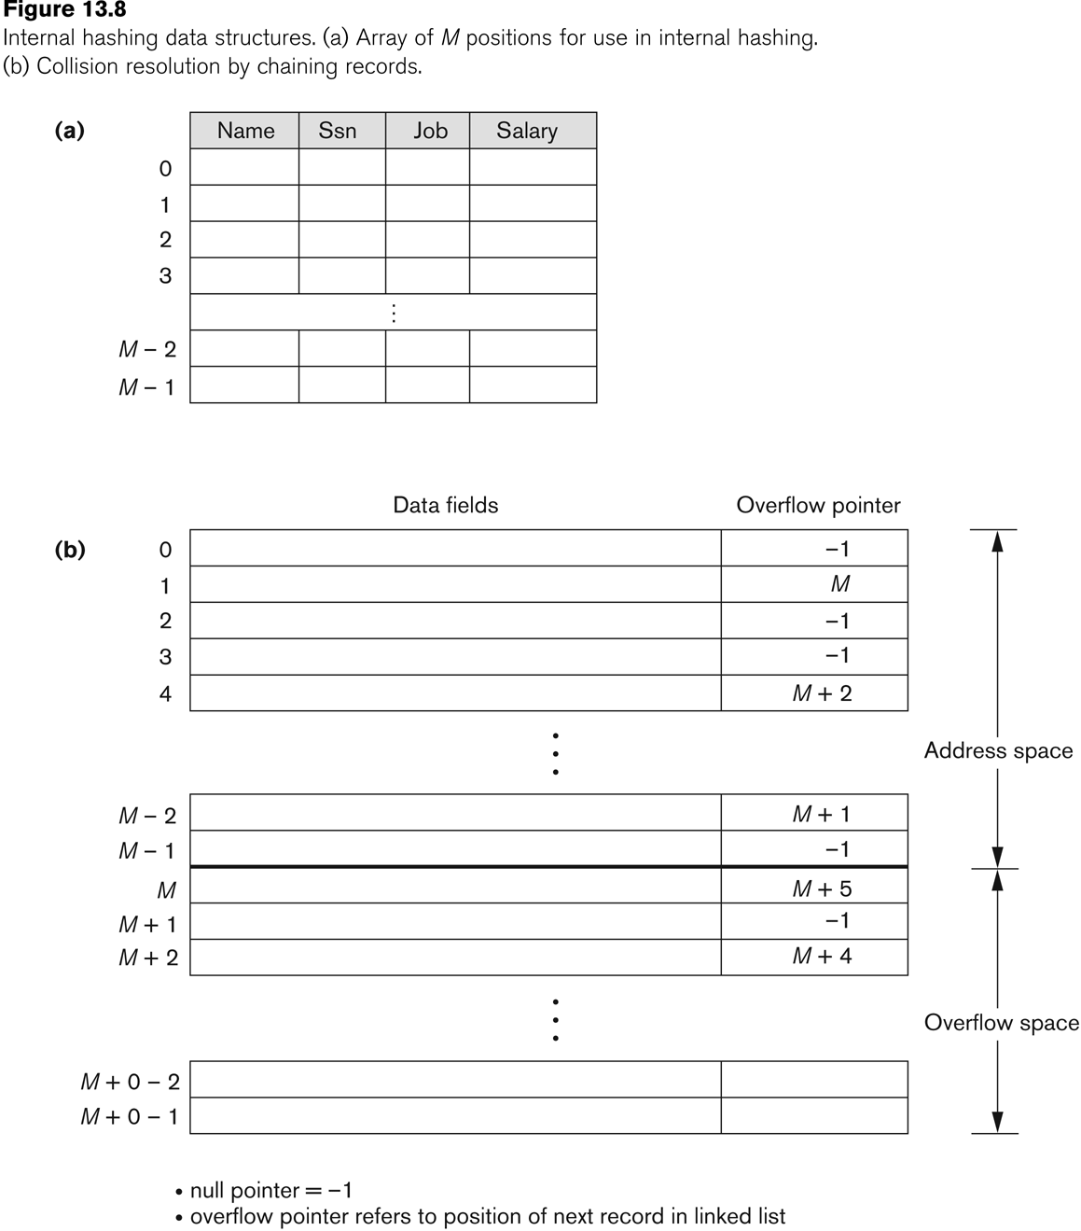
Hashing Techniques: Internal Hashing

Slide 21
Static Hashed Files (External Hashing)
Hashing for disk files is called External Hashing
The file blocks are divided into M equal-sized buckets, numbered bucket₀, bucket₁, ..., bucket_{M-1}.
Typically, a bucket corresponds to one (or a fixed number of) disk block.
One of the file fields is designated to be the hash key of the file.
The record with hash key value K is stored in bucket i, where i=h(K), and h is the hashing function.
Search is very efficient on the hash key.
Collisions occur when a new record hashes to a bucket that is already full.
An overflow file is kept for storing such records.
Overflow records that hash to each bucket can be linked together.

Slide 22
Static Hashed Files (contd.)
There are numerous methods for collision resolution, including the following:
Open addressing: Proceeding from the occupied position specified by the hash address, the program checks the subsequent positions in order until an unused (empty) position is found.
Chaining: For this method, various overflow locations are kept, usually by extending the array with a number of overflow positions. In addition, a pointer field is added to each record location. A collision is resolved by placing the new record in an unused overflow location and setting the pointer of the occupied hash address location to the address of that overflow location.
Multiple hashing: The program applies a second hash function if the first results in a collision. If another collision results, the program uses open addressing or applies a third hash function and then uses open addressing if necessary.

Slide 23
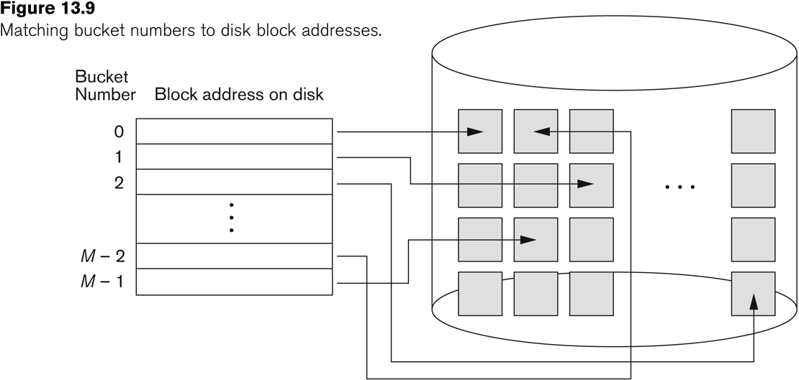
Static Hashed Files (contd.)

Slide 24
Static Hashed Files (contd.)
To reduce overflow records, a hash file is typically kept 70-80% full.
The hash function h should distribute the records uniformly among the buckets
Otherwise, search time will be increased because many overflow records will exist.
Main disadvantages of static external hashing:
Fixed number of buckets M is a problem if the number of records in the file grows or shrinks.
Ordered access on the hash key is quite inefficient (requires sorting the records).

Slide 25
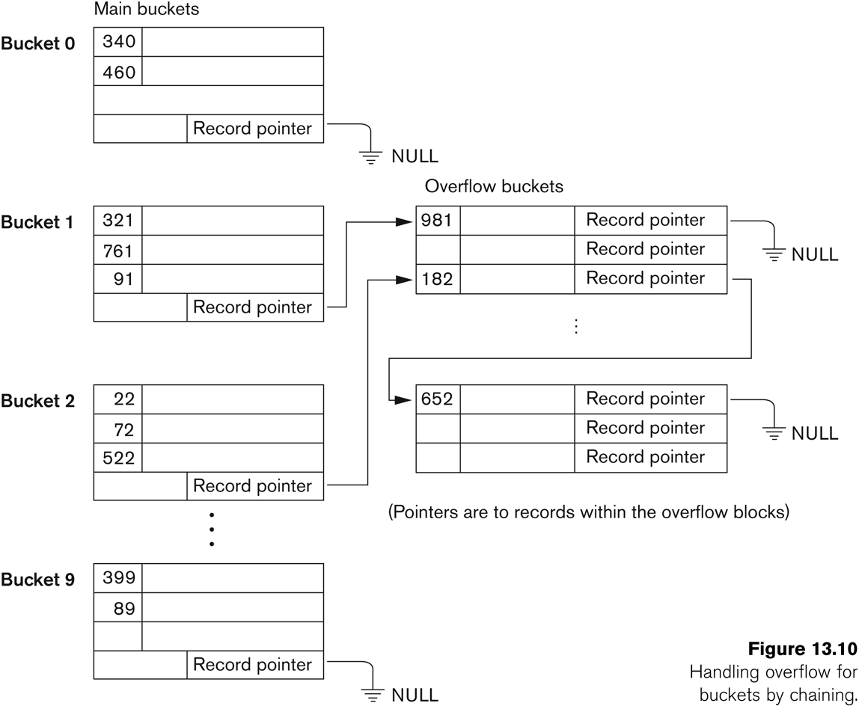
Static Hashed Files - Overflow handling

Slide 26
Hashing Techniques That Allow Dynamic File Expansion
Dynamic and Extendible Hashing Techniques
Hashing techniques are adapted to allow the dynamic growth and shrinking of the number of file records.
These techniques include the following: dynamic hashing, extendible hashing, and linear hashing.
Both dynamic and extendible hashing use the binary representation of the hash value h(K) in order to access a directory.
In dynamic hashing the directory is a binary tree.
In extendible hashing the directory is an array of size 2^{d} where d is called the global depth.

Slide 27
Dynamic And Extendible Hashing (contd.)
The directories can be stored on disk, and they expand or shrink dynamically.
Directory entries point to the disk blocks that contain the stored records.
An insertion in a disk block that is full causes the block to split into two blocks and the records are redistributed among the two blocks.
The directory is updated appropriately.
Dynamic and extendible hashing do not require an overflow area.
Linear hashing does require an overflow area but does not use a directory.
Blocks are split in linear order as the file expands.

Slide 28
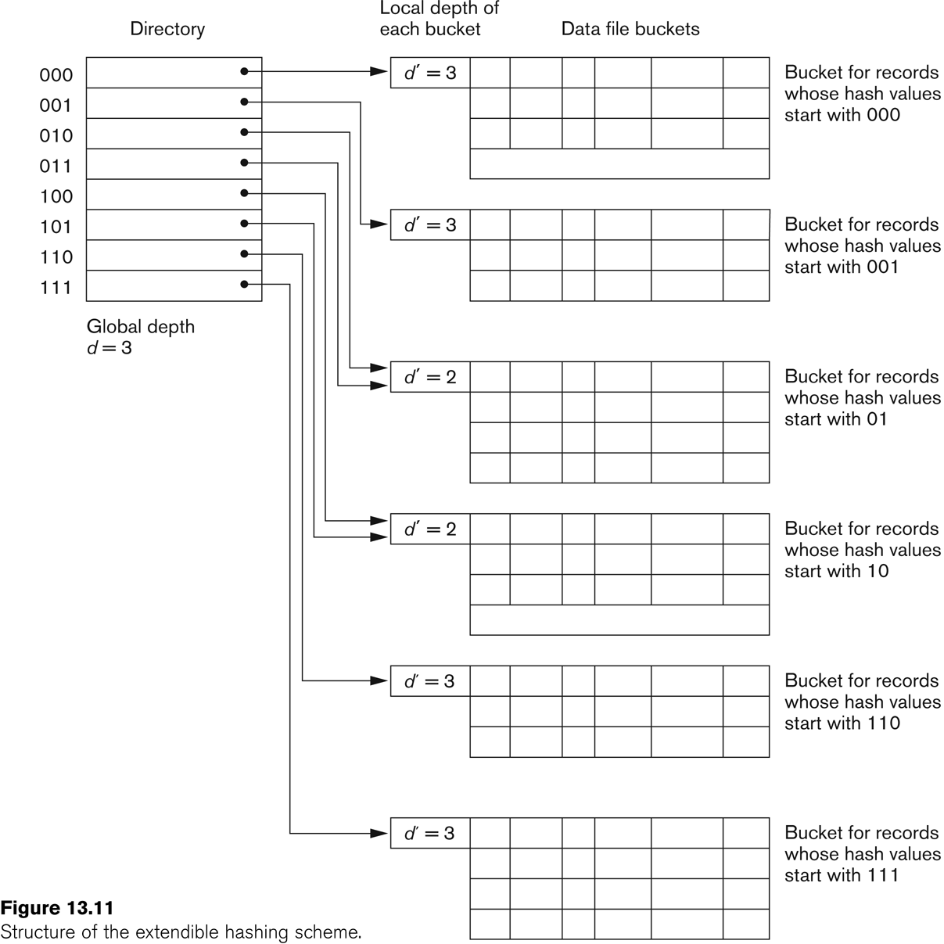
Extendible Hashing

Slide 29
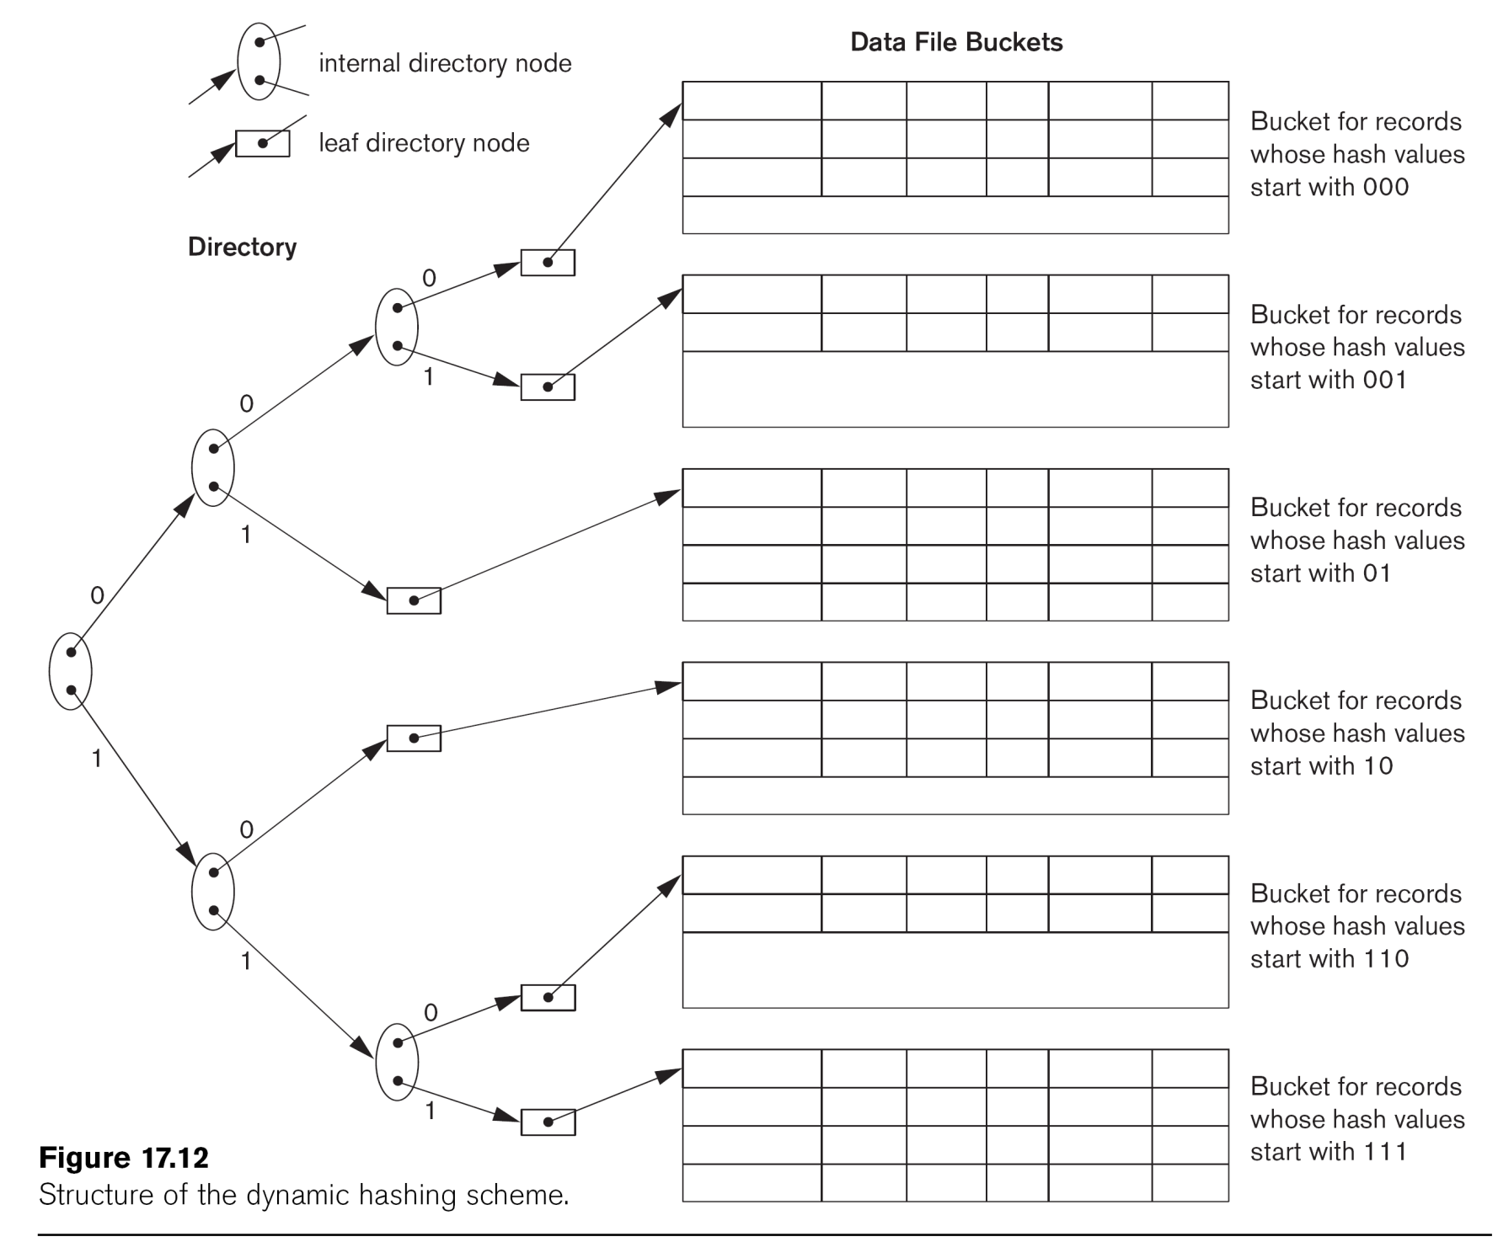
Dynamic Hashing

Slide 30
Linear Hashing
Linear Hashing

Slide 31
Parallelizing Disk Access using RAID Technology.
Secondary storage technology must take steps to keep up in performance and reliability with processor technology.
A major advance in secondary storage technology is represented by the development of RAID, which originally stood for Redundant Arrays of Inexpensive Disks.
The main goal of RAID is to even out the widely different rates of performance improvement of disks against those in memory and microprocessors.

Slide 32
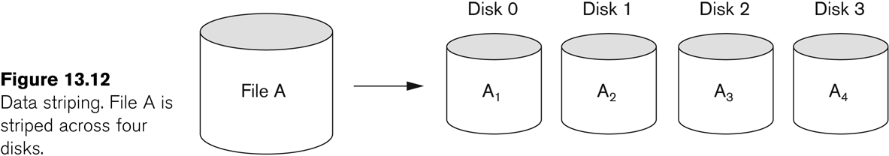
RAID Technology (contd.)
A natural solution is a large array of small independent disks acting as a single higher-performance logical disk.
A concept called data striping is used, which utilizes parallelism to improve disk performance.
Data striping distributes data transparently over multiple disks to make them appear as a single large, fast disk.

Slide 33
RAID Technology (contd.)
Different raid organizations were defined based on different combinations of the two factors of granularity of data interleaving (striping) and pattern used to compute redundant information.
Raid level 0 has no redundant data and hence has the best write performance at the risk of data loss
Raid level 1 uses mirrored disks.
Raid level 2 uses memory-style redundancy by using Hamming codes, which contain parity bits for distinct overlapping subsets of components. Level 2 includes both error detection and correction.
Raid level 3 uses a single parity disk relying on the disk controller to figure out which disk has failed.
Raid Levels 4 and 5 use block-level data striping, with level 5 distributing data and parity information across all disks.
Raid level 6 applies the so-called P + Q redundancy scheme using Reed-Soloman codes to protect against up to two disk failures by using just two redundant disks.

Slide 34
Use of RAID Technology (contd.)
Different raid organizations are being used under different situations
Raid level 1 (mirrored disks) is the easiest for rebuild of a disk from other disks
It is used for critical applications like logs
Raid level 2 uses memory-style redundancy by using Hamming codes, which contain parity bits for distinct overlapping subsets of components.
Level 2 includes both error detection and correction.
Raid level 3 (single parity disks relying on the disk controller to figure out which disk has failed) and level 5 (block-level data striping) are preferred for Large volume storage, with level 3 giving higher transfer rates.
Most popular uses of the RAID technology currently are:
Level 0 (with striping), Level 1 (with mirroring) and Level 5 with an extra drive for parity.
Design Decisions for RAID include:
Level of RAID, number of disks, choice of parity schemes, and grouping of disks for block-level striping.

Slide 35
Use of RAID Technology (contd.)

Slide 36
Use of RAID Technology (contd.)

Slide 37
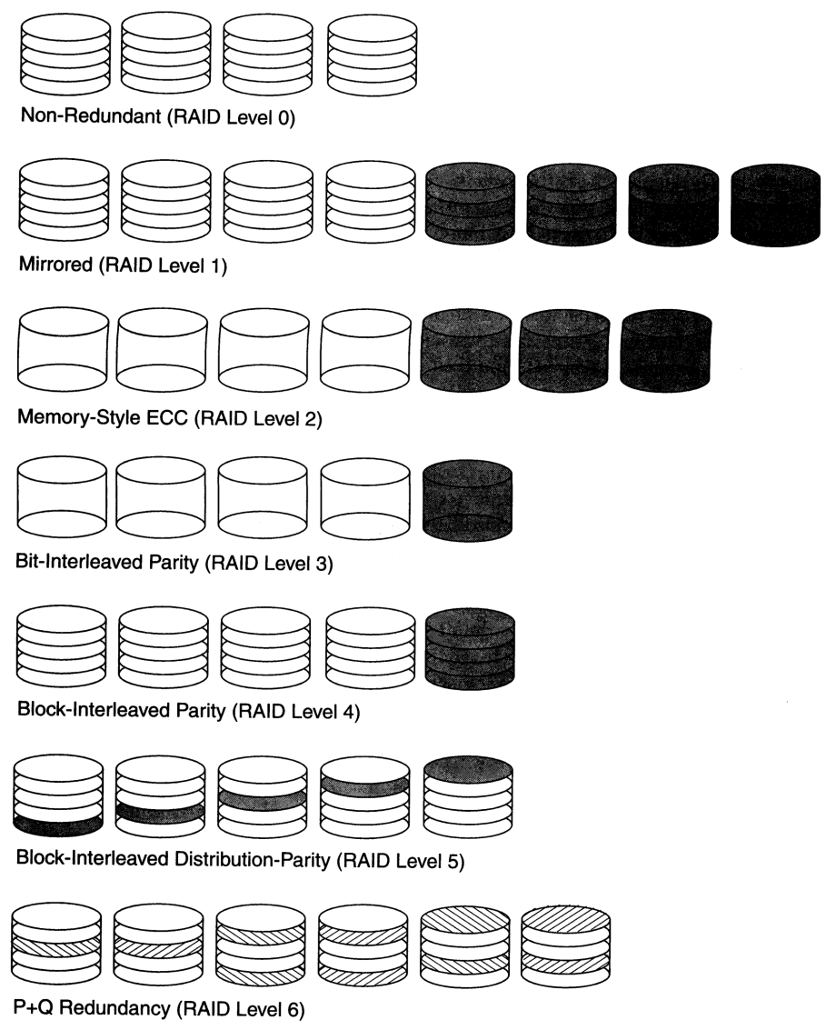
Use of RAID Technology (contd.)

Slide 38
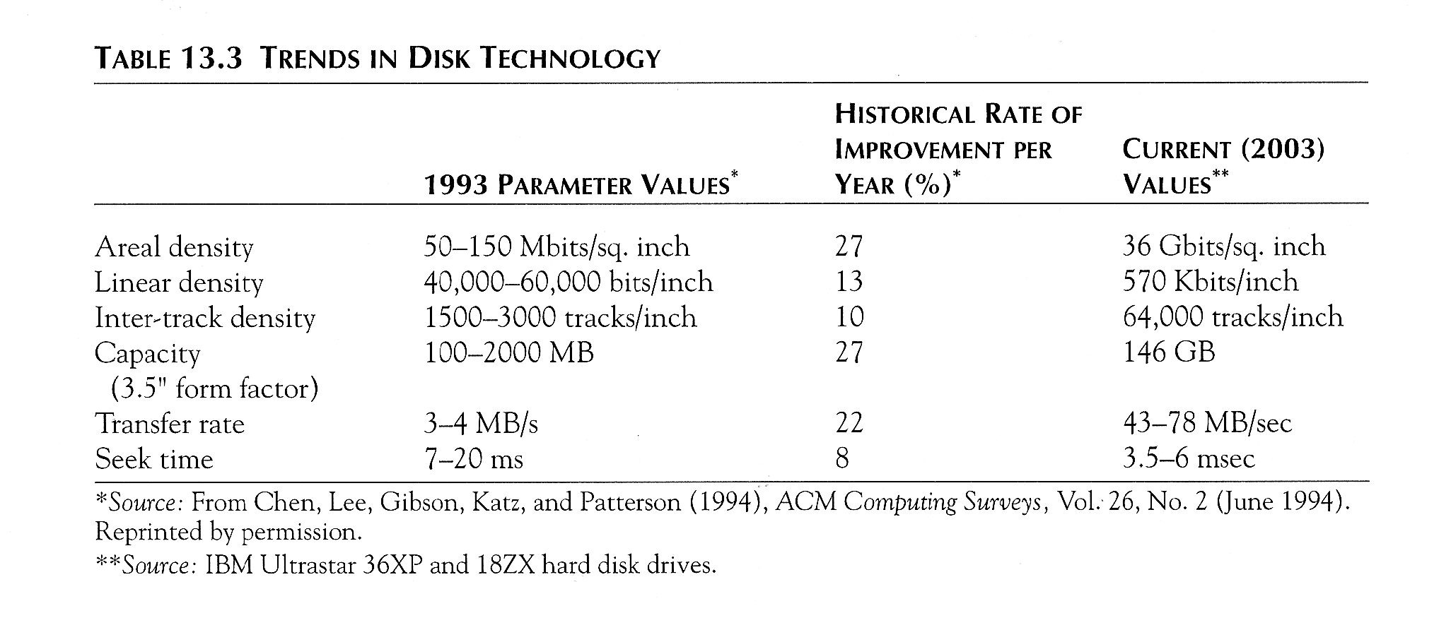
Trends in Disk Technology

Slide 39
Storage Area Networks
The demand for higher storage has risen considerably in recent times.
Organizations have a need to move from a static fixed data center oriented operation to a more flexible and dynamic infrastructure for information processing.
Thus they are moving to a concept of Storage Area Networks (SANs).
In a SAN, online storage peripherals are configured as nodes on a high-speed network and can be attached and detached from servers in a very flexible manner.
This allows storage systems to be placed at longer distances from the servers and provide different performance and connectivity options.

Slide 40
Storage Area Networks (contd.)
Advantages of SANs are:
Flexible many-to-many connectivity among servers and storage devices using fiber channel hubs and switches.
Up to 10km separation between a server and a storage system using appropriate fiber optic cables.
Better isolation capabilities allowing non-disruptive addition of new peripherals and servers.
SANs face the problem of combining storage options from multiple vendors and dealing with evolving standards of storage management software and hardware.

Slide 41
Summary
Disk Storage Devices
Files of Records
Operations on Files
Unordered Files
Ordered Files
Hashed Files
Dynamic and Extendible Hashing Techniques
RAID Technology

Slide 42
Problem 1
A file has r=20000 STUDENT records of fixed-length.
Each record has the following fields:
NAME (30 bytes), SSN (9 bytes), ADDRESS (40 bytes), PHONE (9 bytes),
BIRTHDATE (8 bytes), SEX (1 byte), MAJORDEPTCODE (4 bytes), MINORDEPTCODE (4 bytes), CLASSCODE (4 bytes, integer), and DEGREEPROGRAM (3 bytes). Seek time is 30msec.rotational delay time 12.5 msec and block transfer time 1msec
An additional byte is used as a deletion marker. The file is stored on the disk.
Calculate the record size R in bytes.
Calculate the blocking factor bfr and the number of file blocks b assuming an unspanned organization.
Calculate the average time it takes to find a record by doing a linear search on the file if (i) the file blocks are stored contiguously and double buffering is used, and (ii) the file blocks are not stored contiguously.
Assume the file is ordered by SSN; calculate the time it takes to search for a record given its SSN value by doing a binary search.

Slide 43
Problem 1 (Solution)
Calculate the record size R in bytes.
R = (30 + 9 + 40 + 9 + 8 + 1 + 4 + 4 + 4 + 3) + 1 = 113 bytes
Calculate the blocking factor bfr and the number of file blocks b assuming an unspanned organization.
bfr = floor(B / R) = floor(512 / 113) = 4 records per block
b = ceiling(r / bfr) = ceiling(20000 / 4) = 5000 blocks
Calculate the average time it takes to find a record by doing a linear search on the file if (i) the file blocks are stored contiguously and double buffering is used, and (ii) the file blocks are not stored contiguously.
we search on average half the file blocks= 5000/2= 2500 blocks.
i) the time to read 2500 consecutive blocks
= s+rd+(2500*btt)= 30+12.5+2500*1= 2542.5 msec
ii) Time is: 2500 * (s + rd + btt) = 2500 * (30 + 12.5 + 1)= 08750 msec =108.75 sec
Assume the file is ordered by SSN; calculate the time it takes to search for a record given its SSN value by doing a binary search.
ceiling(log 2 b) * (s +rd + btt)
= ceiling(log 2 5000) * (30 + 12.5 + 1) = 13 * 43.5 = 565.5 msec = 0.5655 sec

Slide 44
Problem 2
Suppose only 80% of the STUDENT records from Problem1 have a value for PHONE, 85% for MAJORDEPTCODE, 15% for MINORDEPTCODE, and 90% for DEGREEPROGRAM,
and we use a variable-length record file. Each record has a 1-byte field type for each field occurring in the record, plus the 1-byte deletion marker and a 1-byte end-ofrecord marker.
Suppose we use a spanned record organization, where each block has a 5-byte pointer to the next block (this space is not used for record storage).
Calculate the average record length R in bytes.
Calculate the number of blocks needed for the file.

Slide 45
Problem 2 (Solution)
Calculate the average record length R in bytes.
R fixed = (30+1) + (9+1) + (40+1) + (8+1) + (1+1) + (4+1) +1+1 = 100 bytes
For the fields (PHONE, MAJORDEPTCODE, MINORDEPTCODE ,DEGREEPROGRAM), the average number of bytes per record is:
R variable = ((9+1)*0.8)+((4+1)*0.85)+((4+1)*0.15)+((3+1)*0.9)
= 8+4.25+0.75+3.6= 16.6 bytes
The average record size R = R fixed + R variable = 100 + 16.6 = 116.6 bytes
The total bytes needed for the whole file = r * R = 20000 * 116.6 = 2332000 bytes
Calculate the number of blocks needed for the file.
The bytes available in each block are (B-5) = (512 - 5) = 507 bytes.
The number of blocks needed for the file are:
b = ceiling((r * R) / (B - 5)) = ceiling(2332000 / 507) = 4600 blocks

Slide 46
Problem 3
Suppose that a disk unit has the following parameters:
seek time s=20 msec; rotational delay rd=10 msec; block transfer time btt=1 msec; block size B=2400 bytes; interblock gap size G=600 bytes.
An EMPLOYEE file has the following fields:
SSN, 9 bytes; LASTNAME, 20 bytes; FIRSTNAME, 20 bytes; MIDDLE INIT,
1 byte; BIRTHDATE, 10 bytes; ADDRESS, 35 bytes); PHONE, 12 bytes);
SUPERVISORSSN, 9 bytes; DEPARTMENT, 4 bytes; JOBCODE, 4 bytes; deletion marker, 1 byte.
The EMPLOYEE file has r=30000 STUDENT records, fixed-length format, and unspanned blocking.
Write down appropriate formulas and calculate the following values for the above EMPLOYEE file:
The record size R (including the deletion marker), the blocking factor bfr, and the number of disk blocks b.
Calculate the wasted space in each disk block because of the unspanned organization.
Calculate the transfer rate tr and the bulk transfer rate btr for this disk.

Slide 47
Problem 3 (Contd.)
Calculate the average number of block accesses needed to search for an arbitrary record in the file, using linear search.
Calculate the average time needed in msec to search for an arbitrary record in the file, using linear search, if the file blocks are stored on consecutive disk blocks and double buffering is used.
Calculate the average time needed in msec to search for an arbitrary record in the file, using linear search, if the file blocks are not stored on consecutive disk blocks.
Assume that the records are ordered via some key field. Calculate the average number of block accesses and the average time needed to search for an arbitrary record in the file, using binary search.

Slide 48
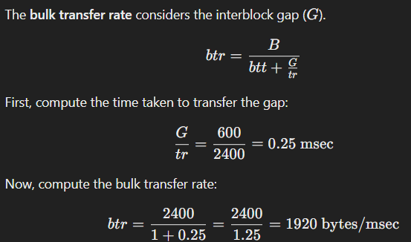
Problem 3 (Solution)
The record size R (including the deletion marker), the blocking factor bfr, and the number of disk blocks b.
R = (9 + 20 + 20 + 1 + 10 + 35 + 12 + 9 + 4 + 4) + 1 = 125 bytes
bfr = floor(B / R) = floor(2400 / 125) = 19 records per block
b = ceiling(r / bfr) = ceiling(30000 / 19) = 1579 blocks
Calculate the wasted space in each disk block because of the unspanned organization.
Wasted space per block = B - (R * Bfr) = 2400 - (125 * 19) = 25 bytes
Calculate the transfer rate tr and the bulk transfer rate btr for this disk.

Slide 49
Problem 3 (Solution)
Calculate the average number of block accesses needed to search for an arbitrary record in the file, using linear search.
For linear search we have the following cases:
i. search on key field:
if record is found, half the file blocks are searched on average: b/2= 1579/2 blocks
if record is not found, all file blocks are searched: b = 1579 blocks
ii. search on non-key field:
all file blocks must be searched: b = 1579 blocks
Calculate the average time needed in msec to search for an arbitrary record in the file, using linear search, if the file blocks are stored on consecutive disk blocks and double buffering is used.
i) Time = s+rd+(n*btt)= 20+10+(1579/2)*1= 819.5 msec
ii) Time = s+rd+(n*btt)= 20+10+1579*1= 1609 msec

Slide 50
Problem 3 (Solution)
Calculate the average time needed in msec to search for an arbitrary record in the file, using linear search, if the file blocks are not stored on consecutive disk blocks.
the time to search n blocks is: n * (s + rd + btt)
i) if n=b/2: time = (1579/2)*(20+10+1)= 24474.5 msec = 24.475 sec
ii) if n=b: time = 1579*(20+10+1)= 48949 msec = 48.949 sec
Assume that the records are ordered via some key field. Calculate the average number of block accesses and the average time needed to search for an arbitrary record in the file, using binary search.
The time to search for a record is estimated as: ceiling(log 2 b) * (s +rd + btt)
= ceiling(log 2 1579) * (20+10+1) = 11 * 31 = 341 msec = 0.341 sec

Slide 51
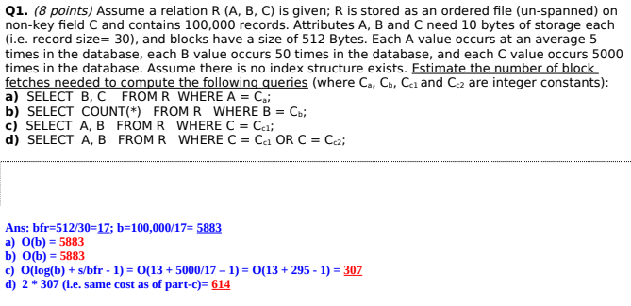
Problem 4 (Previous Exam Question)

Slide 52
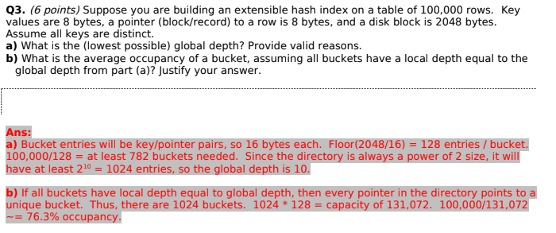
Problem 5 (Previous Exam Question)

Slide 53
Problem 6 (Static Hashing)
A PARTS file with Part# as hash key includes records with the following Part# values:
2369, 3760, 4692, 4871, 5659, 1821, 1074, 7115, 1620, 2428, 3943, 4750, 6975, 4981, 9208.
The file uses 8 buckets, numbered 0 to 7. Each bucket is one disk block and holds two records. Load these records into the file in the given order using the hash function h(K)=K mod 8.
Calculate the average number of block accesses for a random retrieval on Part#.

Slide 54
Problem 6 (Solution)
2369 1 2368 mod 8=1
3760 0
4692 4
4871 7
5659 3
1821 5
1074 2
7115 3
1620 4
2428 4 overflow
3943 7
4750 6
6975 7 overflow
4981 5
0
Two records out of 15 are in overflow, which will require an additional block access.
The other records require only one block access.
The average time to retrieve a random record is:
(1 * (13/15)) + (2 * (2/15)) = 0.867 + 0.266 = 1.133 block accesses
Max two records can stay in one bucket

Slide 55
Problem 7 (Extendible Hashing)
Load the records of Problem1 into expandable hash files based on extendible hashing.
Show the structure of the directory at each step.
Show the directory at each step, and the global and local depths.
Use the has function h(k) = K mod 32.
Max 2 records can be kept into one bucket

Slide 56
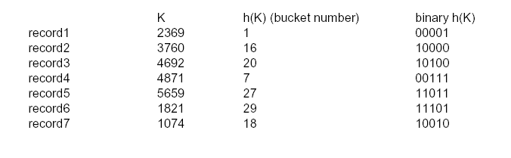
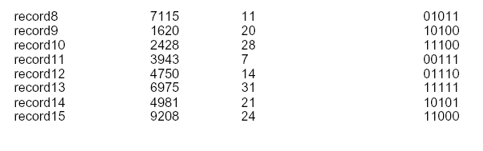
Problem 7 (Solution)

Slide 57
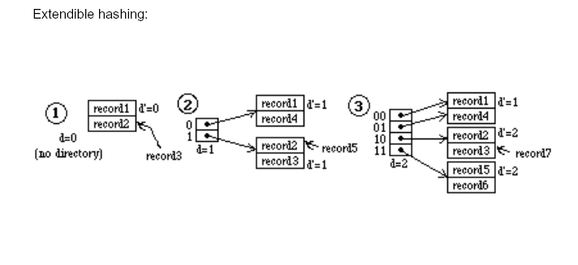
Problem 7 (Solution) (Contd.)

Slide 58
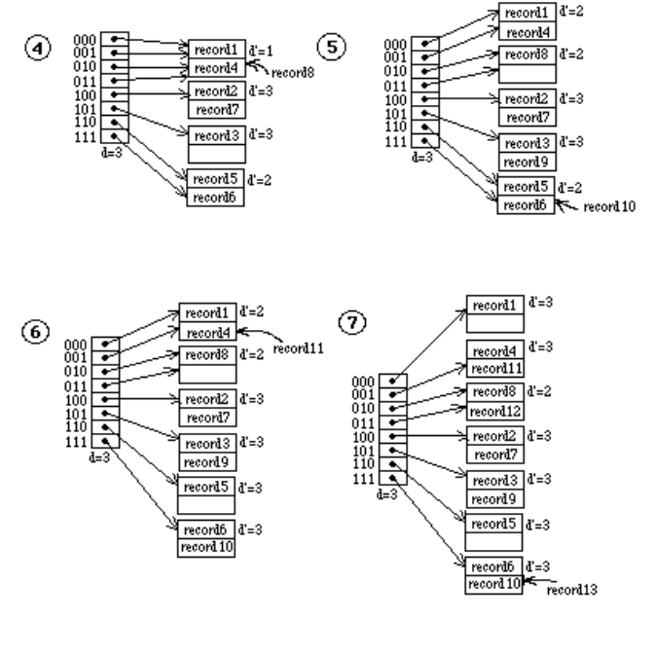
Problem 7 (Solution) (Contd.)

Slide 59
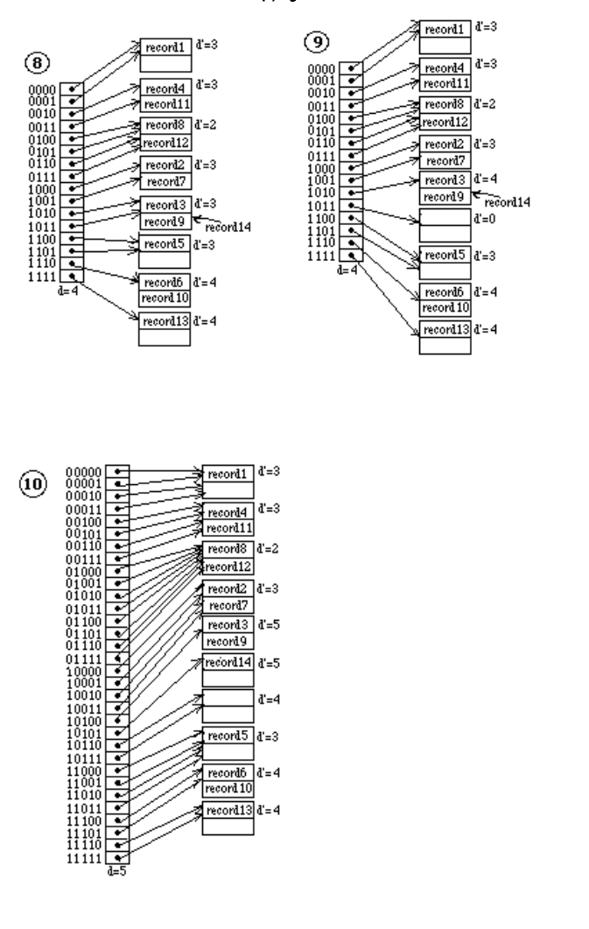
Problem 7 (Solution) (Contd.)

Slide 60
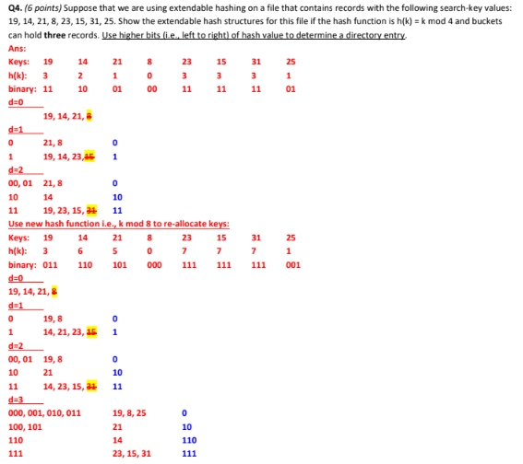
Previous Exam Question

